Slide 1
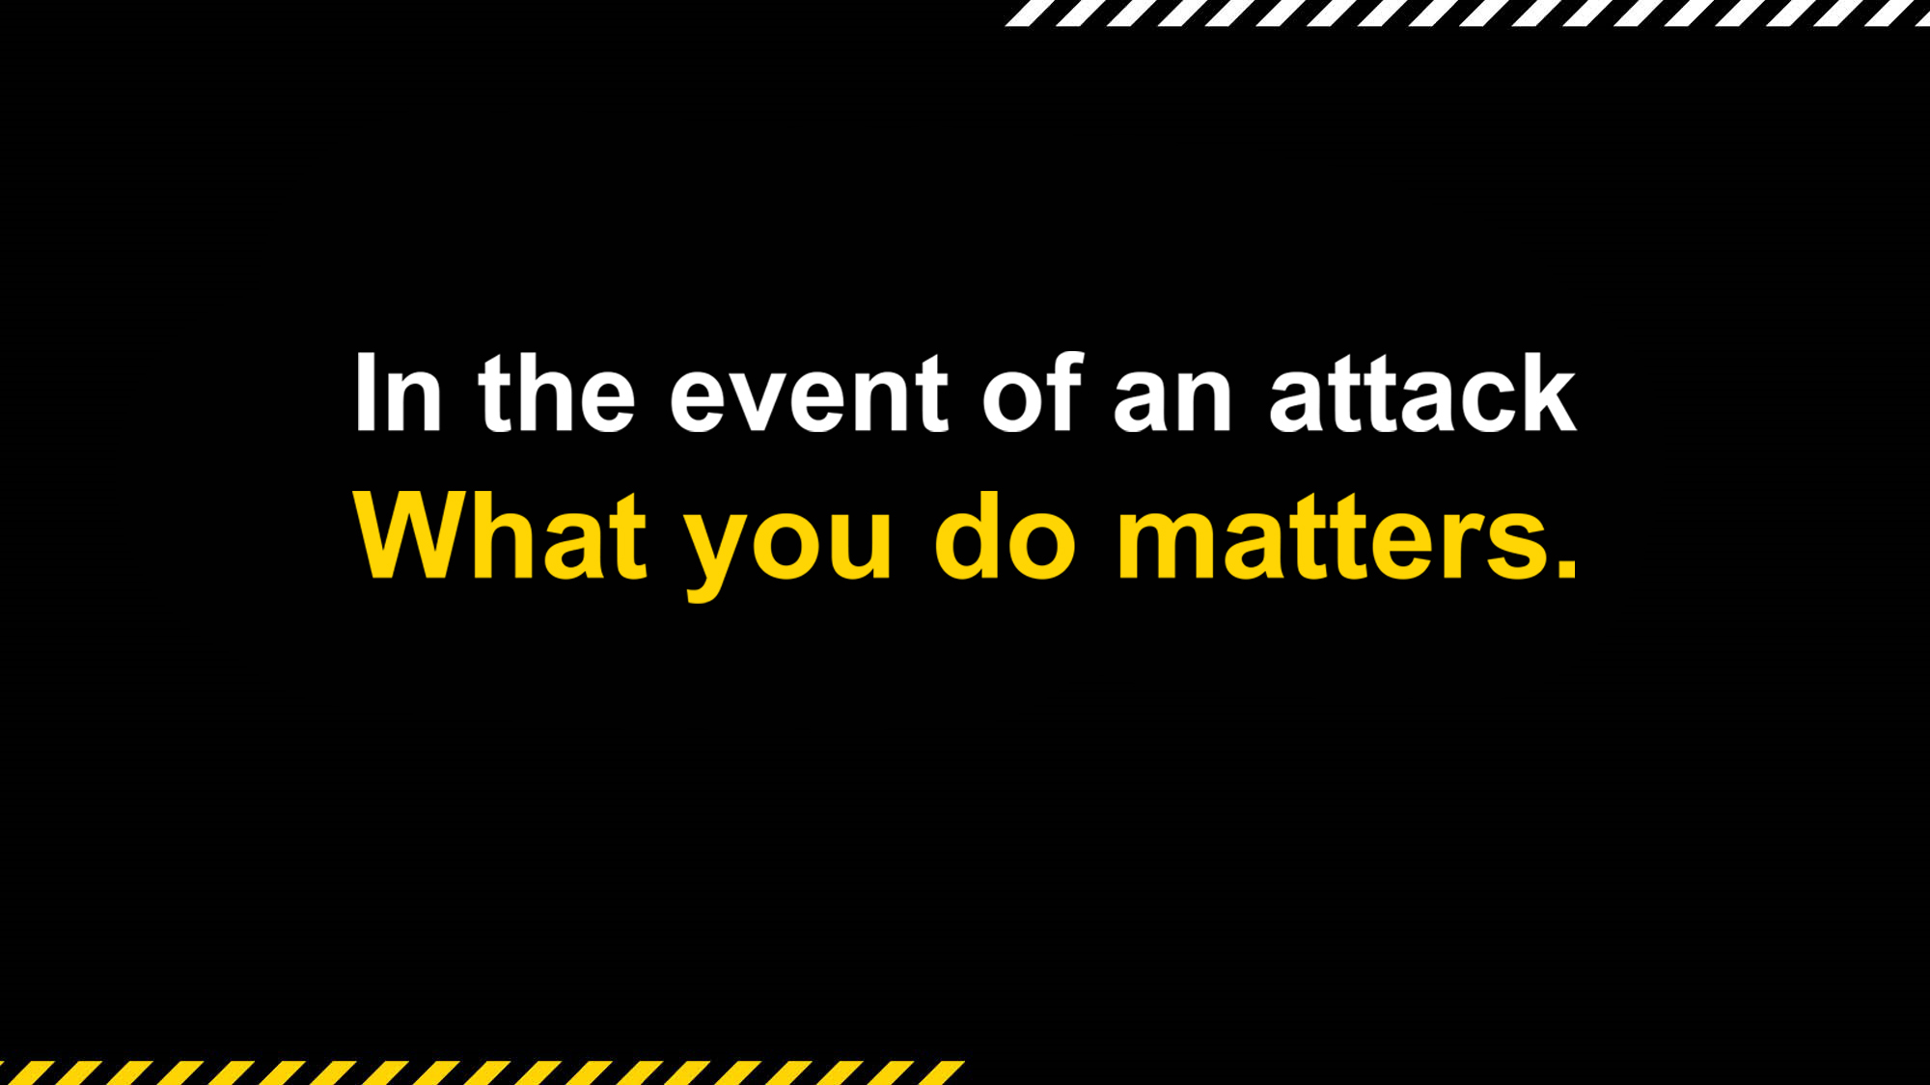
nationalsecurity.gov.au

Slide 2


What you do matters
The chance of being caught up in an attack is low.
It is important that you think about how you should respond.
What you do matters.
Following this advice can save lives.

Slide 3

Active armed offender attacks
An offender or multiple offenders actively attacking people.
Weapons include guns, knives or other objects.
There are 3 words for keeping safe in an attack.
ESCAPE. HIDE. TELL
Following this advice can save lives.

Slide 4


ESCAPE
If you see a safe route, ESCAPE.
Move quickly and quietly away from danger.
Tell others not to enter the area, but only if it doesn’t put you in any danger.
Take your mobile phone.
Do not let your belongings impede your ESCAPE.
Move as far away from the danger area as possible.

Slide 5


HIDE
If you are unable to escape, HIDE.
Stay out of sight and silence your phones.
Move away from doors and remain quiet.
Try and put a sturdy physical barrier between you and the offender.
Help others but only if it does not put you or others at risk.
Constantly review the situation and your options based on the best available information.

Slide 6


TELL
When it is safe to do so, TELL.
Call the police by dialling Triple Zero (000) when it is safe.
You may be asked about your location, surroundings, the attackers and the events that have occurred.
You may be asked to stay on the line and provide further information that the operator requests or if the situation changes.

Slide 7
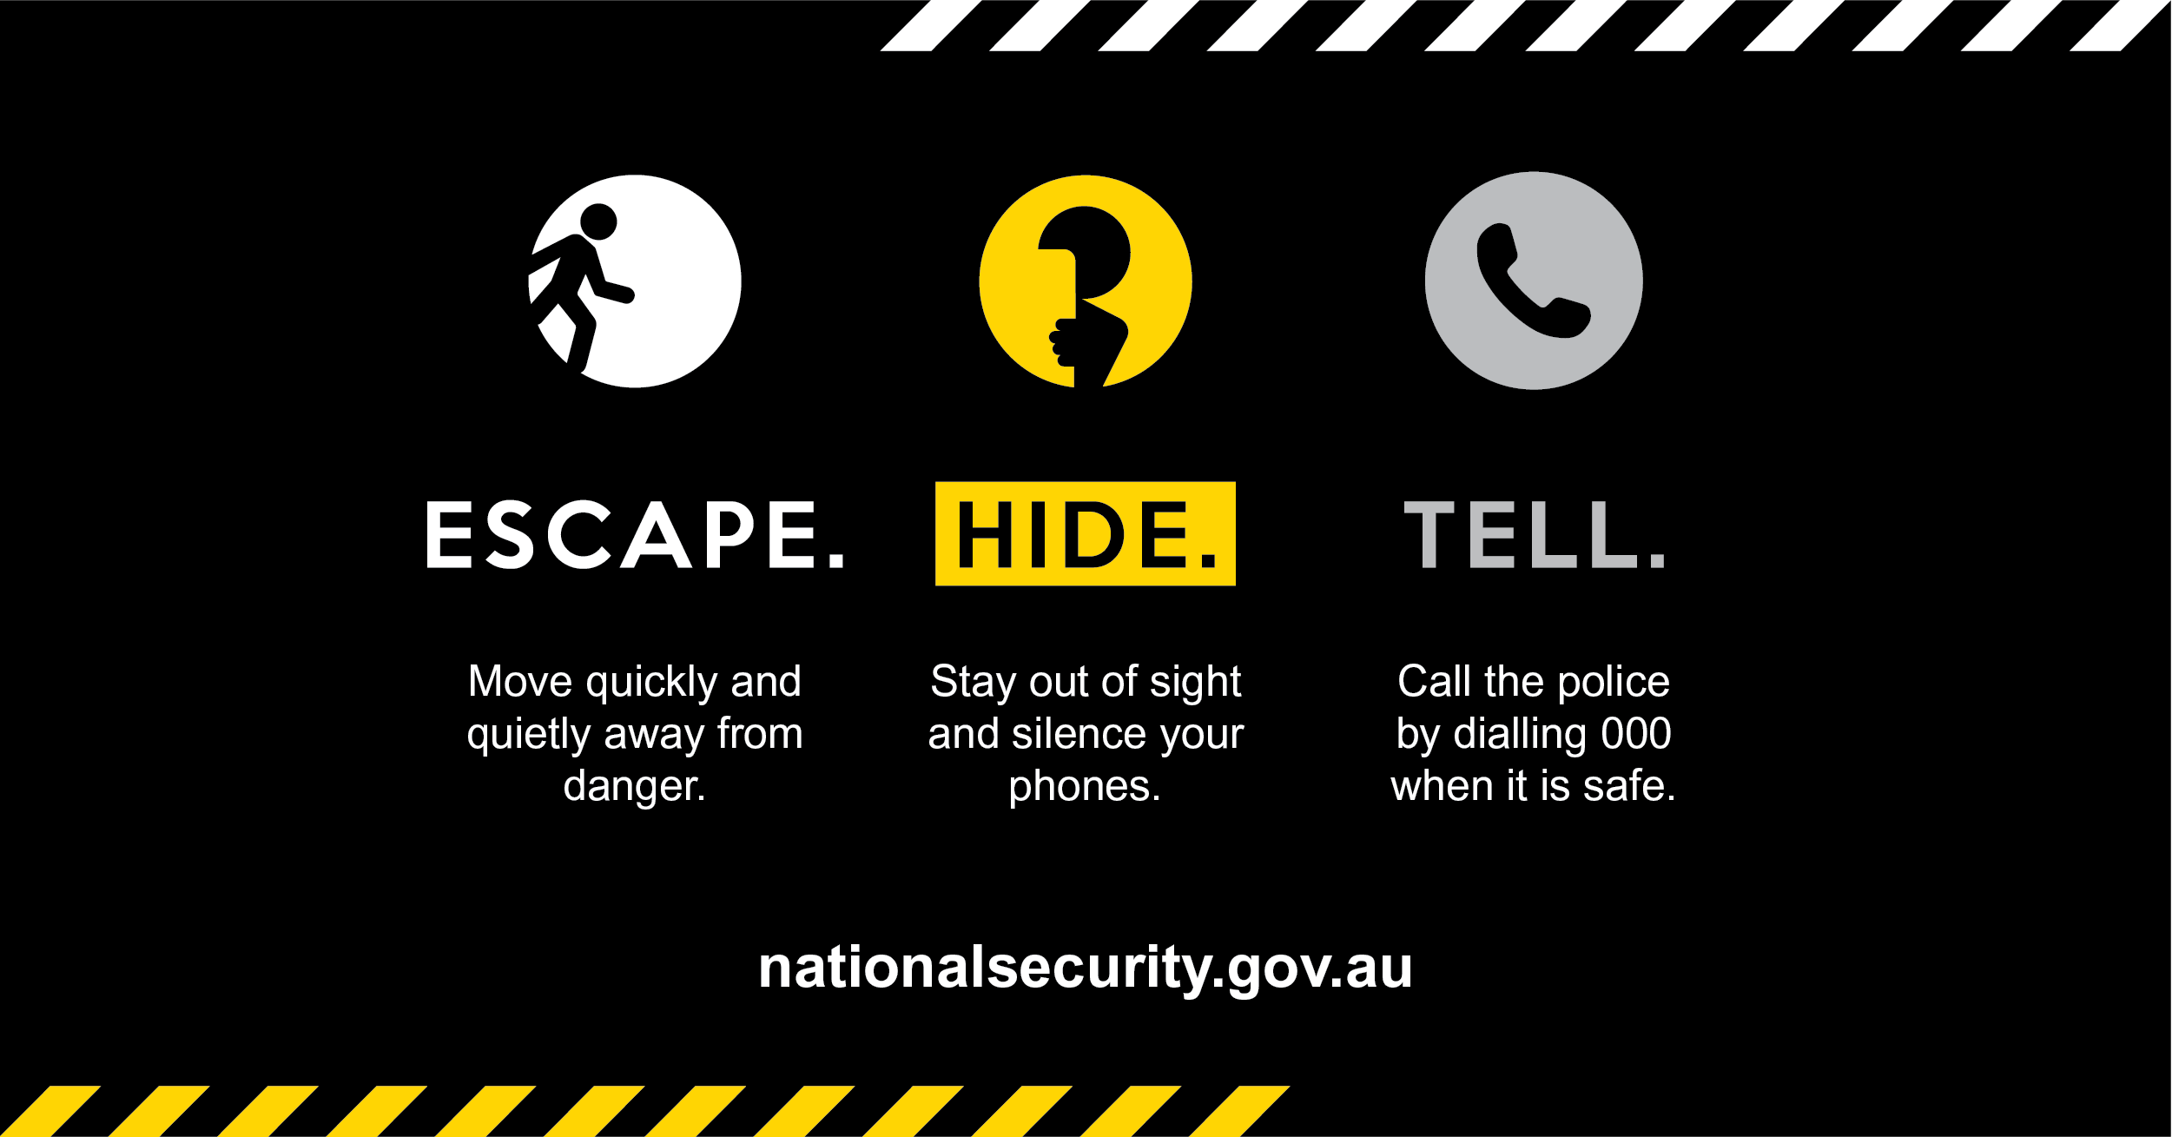

Slide 8
Improvised explosive device attacks
Home made bombs or other explosives.
There can be a risk of a second device in the vicinity.
Leaving helps avoid falling debris.
If you are nearby…
Do not move closer to see what is happening
LEAVING THE BUILDING
Use the stairs instead of lifts.
Be aware of weakened floors and stairways.
Once out, move away from windows, glass doors or other dangerous areas.
IF YOU ARE TRAPPED
If trapped inside, get under a sturdy table or desk
If it is safe and you are able, signal your location to rescuers

Slide 9
Chemical weapons attacks
Obvious signs – eye irritation, coughing/breathing difficulties, muscle weakness, seizures, skin irritation.
Signs that may not be obvious - leakage of gas or vapour, a chemical reaction, or a powder/liquid with no obvious explanation.
Enclosed space – get to uncontaminated air quickly.
Outdoor space – avoid any obvious plume/vapour cloud, and move upwind/uphill.
If you think you have been exposed :
tell an emergency responder ASAP that you think you may have been exposed
seek medical attention
remove outer clothing if contaminated and place in a sealed bag
wash yourself with soap and water, flush skin with lots of water, and flush eyes with water if they are irritated
put on clean clothes if possible.

Slide 10

Hostile vehicle attacks
A driver deliberately drives a vehicle into pedestrians.
A hostile vehicle may also carry an explosive device.
ESCAPE THE AREA
Move to an area that puts as many obstacles between you and the vehicle as possible but doesn’t leave you trapped

Slide 11

Mixed mode attacks
An attack that involves one or more types of attack.
Always maintain awareness of what is happening around you, so you can change your response to suit the situation.

Slide 12
Police response
When police arrive, follow their instructions.
Their priority will be to deal with the immediate threat to prevent further injury.
You should follow all instructions given by emergency responders.
Police may not be able to distinguish you from the offenders.
You will be evacuated when it is safe to leave the area.
It is important to remember:
police officers will be armed and could
point guns in your direction
police may treat you firmly
avoid quick movements or shouting and keep your hands visible
police priority is to locate the offender.

Slide 13

Your plan must be flexible
Every situation is different
You will need to make decisions
when an attack is unfolding.
Adjust your plan as you go.
Any attack can become a mixed
mode attack very quickly.

Slide 14
BUSINESS CONSIDERATIONS
What you do matters

Slide 15

What you can do to prepare
Be aware of your role and responsibilities within our emergency evacuation plans.
Be aware of evacuation routes, including identifying alternative routes.
Consider how you will communicate evacuation routes to people during an incident.
Think about how you can apply the ESCAPE. HIDE. TELL. principles to our business.

Slide 16

Resources to help our business
Australia’s Strategy for Protecting Crowded Places from Terrorism
Active Armed Offender Guidelines for Crowded Places
Improvised Explosive Device Guidelines for Crowded Places
Chemical Weapon Guidelines for Crowded Places
Hostile Vehicle Guidelines for Crowded Places.
nationalsecurity.gov.au

